Slide 1


2020 @

Slide 2
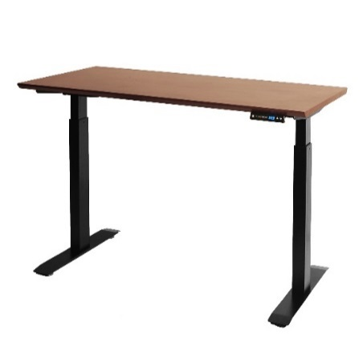
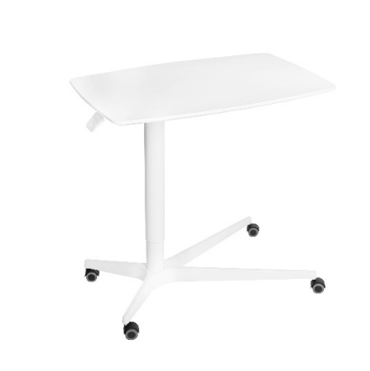
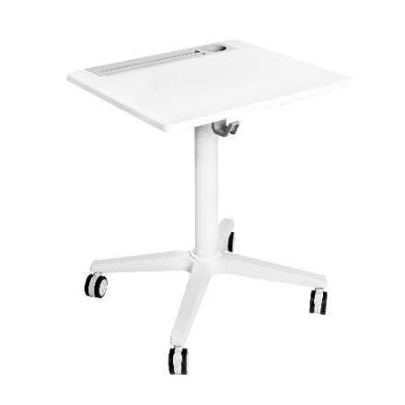
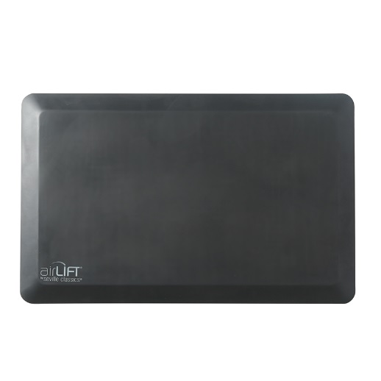
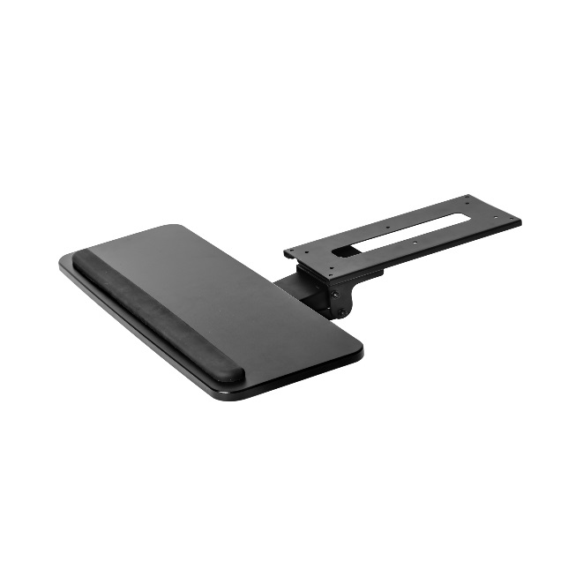
Where We Are
The AIRLIFT line was introduced in 2017 and eventually earned a market with commercial customers without explicitly focusing on them. In the following years, our sales to corporations and institutions have directed us to several popular new products (Medical Over-the-Bed Desk, Sit-Stand Student Desk, and USB Wood Desk). We've also found some success with office accessories in the anti-fatigue comfort mats and the keyboard tray specifically.
These successes have given us some perspective on what the market wants in a commercial office assortment.
OFF65880
OFF65905
OFF65903
MSC55929
OFF65856

Slide 3
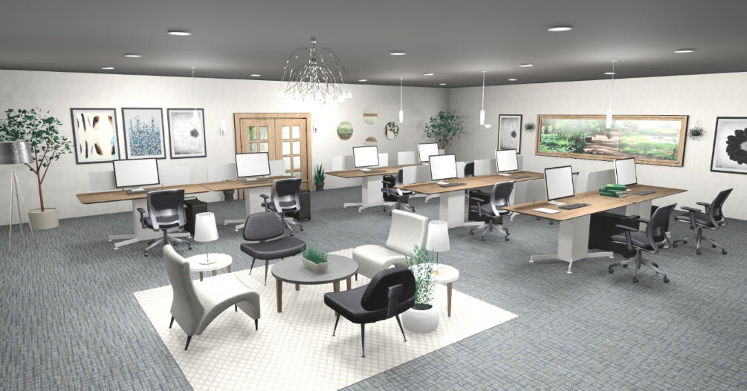
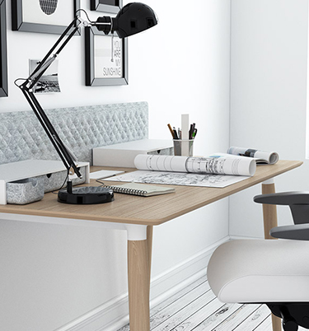
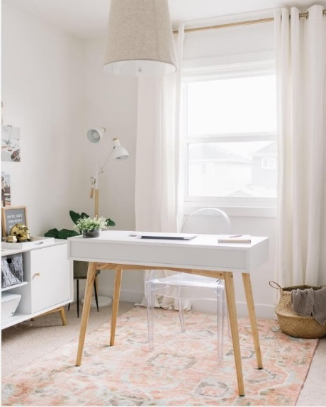
Trends in Commercial Furniture
2020
DESIGN STYLE
TRENDS
COOL COLOR SHADES
Cool color shades and muted tones help to concentrate.
Brown, beige, cool gray, wood and walnut tones are the dominant colors for office 2020. Wooden home office décor is inseparable from this style.

Slide 4
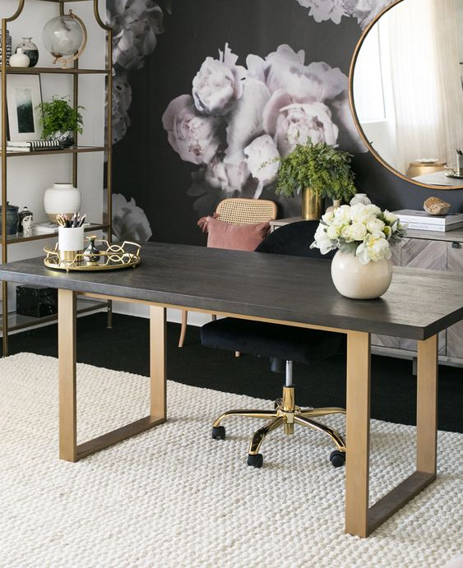
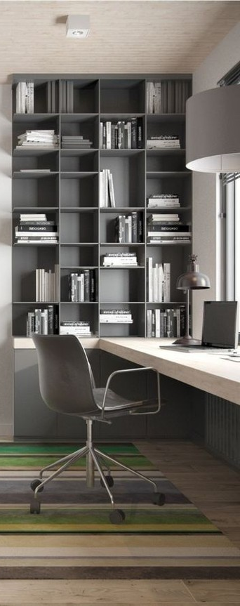

Trends in Commercial Furniture
2020
DESIGN STYLE
TRENDS
MODERN MIXTURE WITH CLASSICS
DESIGN / TRANSITIONAL STYLE
Classical furniture with modern materials are trending in 2020.
Silver and gray tones give an added charm to wooden elements.

Slide 5
2020 Product Roadmap : Where We're Going
C
Next Generation Electric Height Adjustable Dining, Lunchroom and Conference Table

Slide 6
2020 Product Roadmap : Where We're Going
D

Slide 7
2020 Product Roadmap : Where We're Going
E

Slide 8
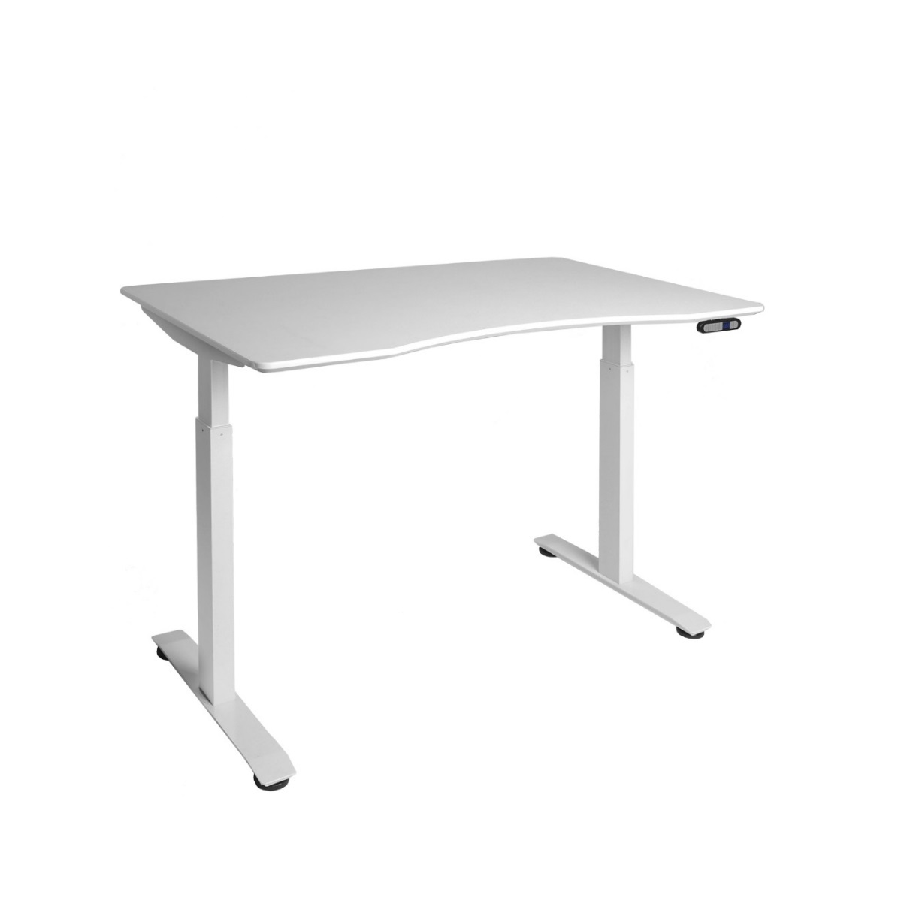



2020 Product Roadmap : Where We're Going
S2+ (ET123)
Height Range: 27.2" H to 46.5" H
Speed: 1.25" per second
Weight Capacity: 220 lbs
FOB: $179.5
2-way anti-collision (stops on contact) Gyroscope: Senses when the table is not level and stops adjustment. Collision Detection: Senses when the table is obstructed and stops.
Auto-leveling base
"Knocking" adjustment
5-year electronics warranty

Slide 9
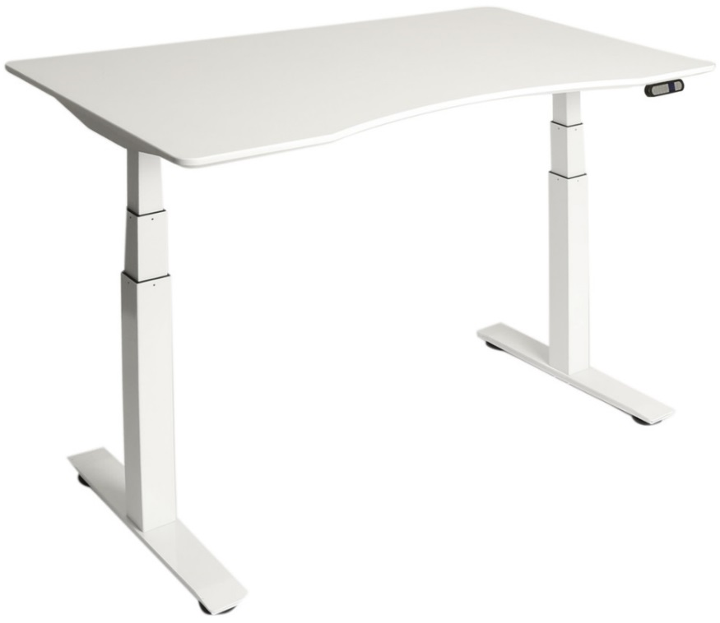

2020 Product Roadmap : Where We're Going
S3+ (ET223), S3+ High Speed
Height Range: 22.8" H to 48.4" H
Speed: 1.5" to 3.1" per second (high speed model)
Weight Capacity: 275 lbs.
FOB: $197.5 to $212.5 (high speed)
3-way anti-collision (stops before contact) Infrared Sensors: Detect when an obstruction is beneath the desk and stops adjustment before contact. 2-Way Anti-Collision: Includes the gyroscope and collision detection.
Auto-leveling base Gyroscopic sensor keeps the table top level even when the base isn't.
"Knocking" adjustment Sonic sensor detects
5-year electronics warranty

Slide 10
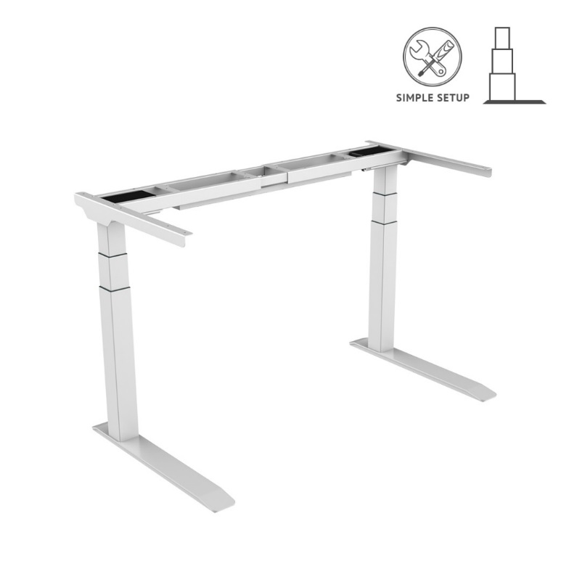

Additional New Features
C-Legs
They offer C-shaped leg designed to work with cabinets that they also offer.
Wireless Charging add-on
Qi-wireless chargers built into the desktop is also an option.
More Controller Options
with timer, USB charging, locking screen, physical buttons and more

Slide 11
2020 Product Roadmap : Where We're Going
A complete sit-stand assortment is valuable for the commercial office space. While the AIRLIFT standing desk stool has been popular, there's a clear demand for full-size drafting chairs.
These chairs are perfect for standing desks for a few reasons:
More Range
These chairs go higher for use with raised tables. They're more comfortable for a wider range of body types too.
Foot Rest
A ring-shaped foot rest keeps users comfortable while lifted and seated. Users will be able move from sit-to-stand immediately without adjusting the desk.

Slide 12
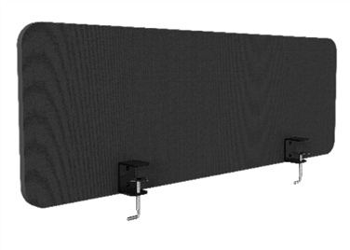
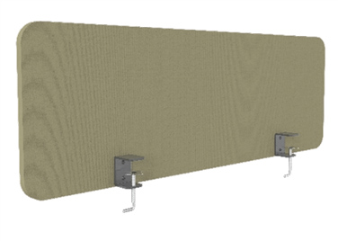
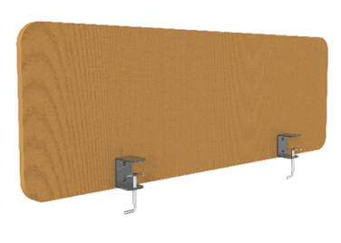
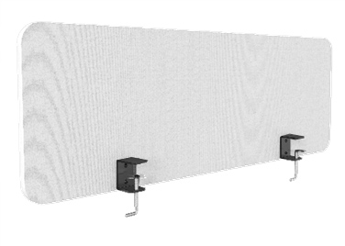
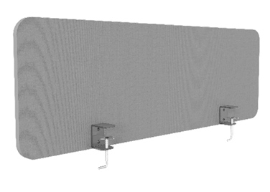
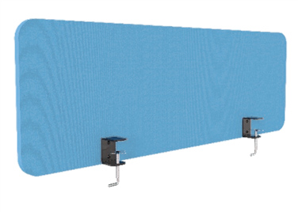
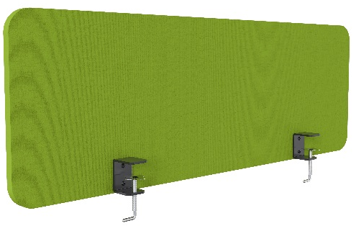
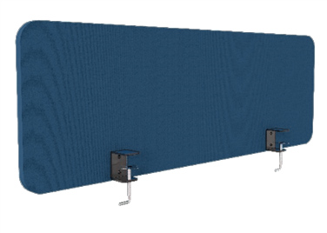
2020 Product Roadmap : Where We're Going
Privacy panels allow customers to build closed and open office spaces. This is important for designers and architects when they're creating plans for their customers.
These panels will help us appeal to the need for versatility.
Privacy Panel

Slide 13
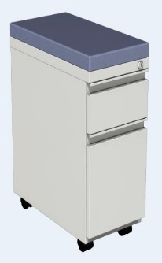
2020 Product Roadmap : Where We're Going
2-Drawer Mini-Pedestal Cabinet
Specifications
Dimensions: 23.5" D x 11.8" W x 27.7" H
Material: Steel body
Color: White
Drawers: 2
Casters: Yes
Features
Raised cabinet designed to fit over electric standing desk feet
Removable plush cushioned top
Ball-bearing drawer rails for smooth operation
Four (4) black plastic casters, 2 locking
Key lock for all drawers
Gray cushion
White cabinet
Black cushion
Black cabinet

Slide 14
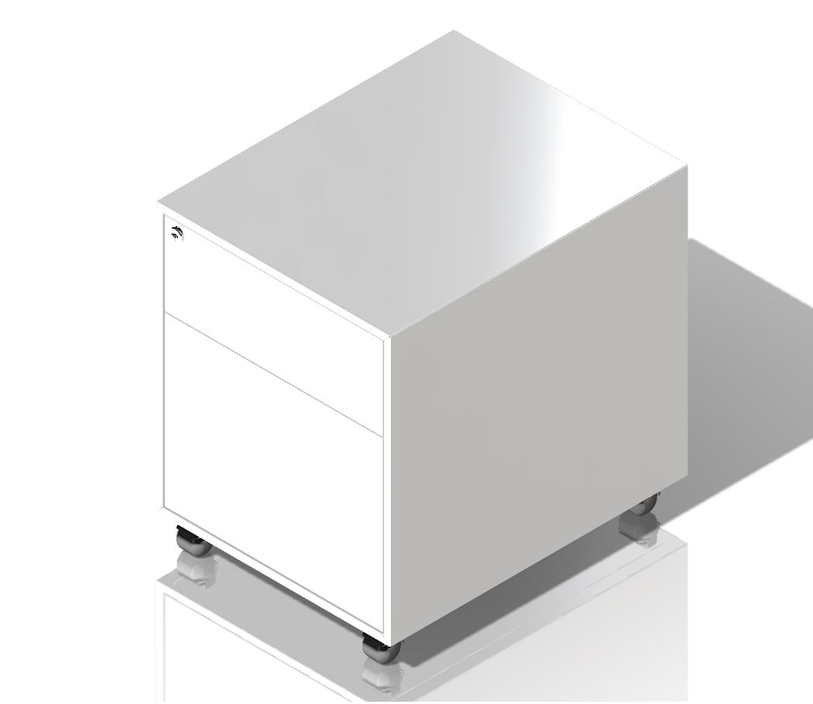
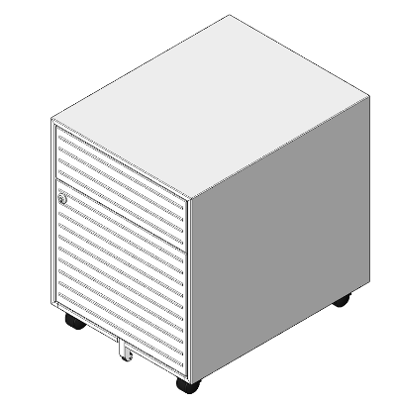
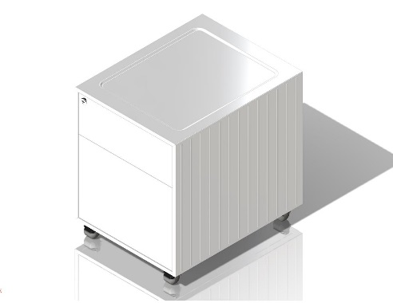
2020 Product Roadmap : Where We're Going
1-Drawer Mini-Pedestal Cabinet
Specifications
Material: Steel body
Color: White
Drawers: 1
Casters: Yes
Features
Raised cabinet designed to fit over electric standing desk feet
Removable plush cushioned top
Ball-bearing drawer rails for smooth operation
Four (4) black plastic casters, 2 locking
Key lock for drawer

Slide 15
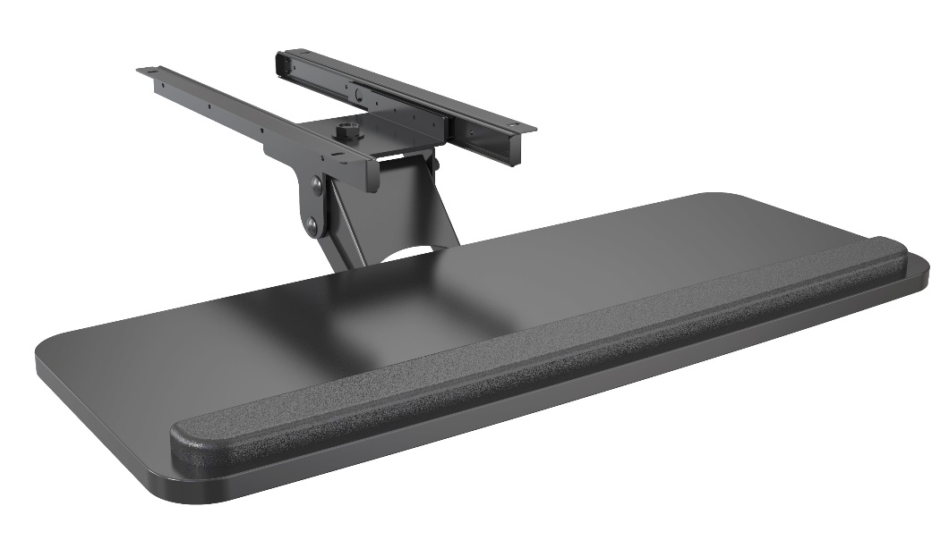
2020 Product Roadmap : Where We're Going
Adjustable Under-the-Desk Sliding Ball-Bearing Keyboard & Mouse Tray
Specifications
Dimensions: 25" W x 9.8" D
Extension range: 5.9"
Materials: Steel frame with MDF tray
Weight capacity: 11 lbs.
Features
Tilt & Swivel articulating tray for comfortable use
Thick foam padded wrist rest
Ball-bearing sliders make it easy to retract and extend
Durable MDF construction with heavy-duty steel brackets
Smooth all black finish

Slide 16
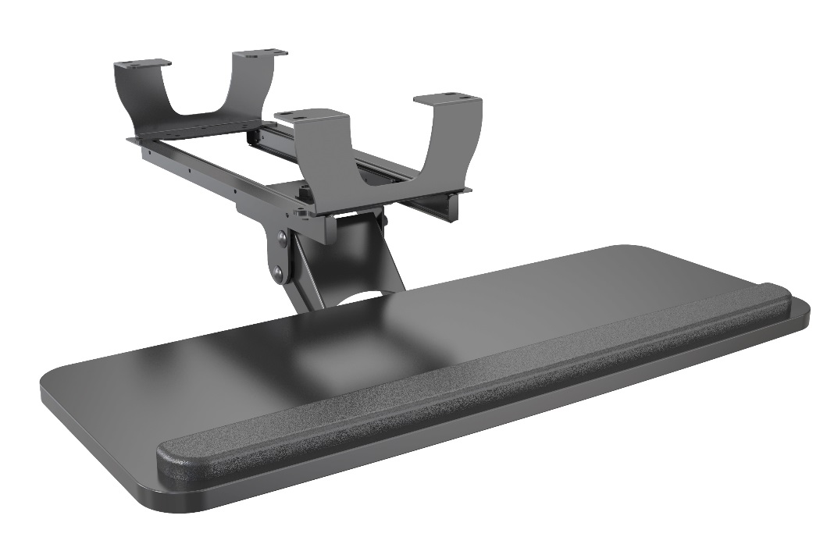
2020 Product Roadmap : Where We're Going
Electric Standing Desk Adjustable Ball-Bearing Keyboard Tray
Specifications
Dimensions: 25" W x 9.8" D
Extension range: 5.9"
Materials: Steel frame with MDF tray
Weight capacity: 11 lbs.
Features
Extended-height bracket designed to fit beneath AIRLIFT electric height adjustable standing desks
Tilt & Swivel articulating tray for comfortable use
Thick foam padded wrist rest
Ball-bearing sliders make it easy to retract and extend
Durable MDF construction with heavy-duty steel brackets
Smooth all black finish

Slide 17
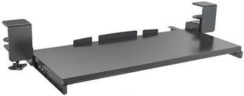
2020 Product Roadmap : Where We're Going
Clamp-On Sliding Keyboard Tray
Specifications
Dimensions: 26.7" W x 11" D x .6" H
Extension range: 0" to 8.7"
Materials: Steel and plastic hardware. MDF tray
Weight capacity: 11 lbs.
Features
Simple clamp-on design works with more desk tops
Ball-bearing sliders make it easy to retract and extend
Durable MDF constructions with heavy-duty steel brackets
Smooth all black finish

Slide 18
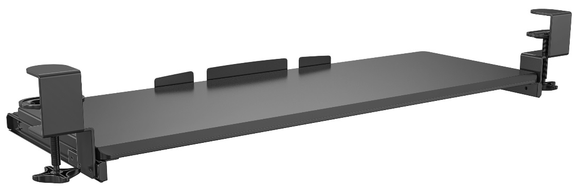
2020 Product Roadmap : Where We're Going
31.5" Wide Clamp-On Sliding Keyboard Tray
Specifications
Dimensions: 31.5" W x 11" D x .6" H
Extension range: 0" to 8.7"
Materials: Steel and plastic hardware. MDF tray
Weight capacity: 11 lbs.
Features
Simple clamp-on design works with more desk tops
Ball-bearing sliders make it easy to retract and extend
Durable MDF constructions with heavy-duty steel brackets
Smooth all black finish

Slide 19
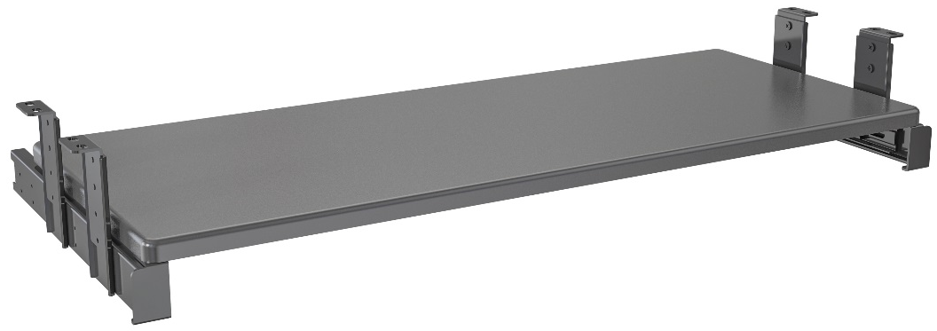
2020 Product Roadmap : Where We're Going
Ball-Bearing Under-the-Desk Keyboard Tray
Specifications
Dimensions:
Extension range:
Materials:
Weight capacity:
Features
Simple clamp-on design works with more desk tops
Ball-bearing sliders make it easy to retract and extend
Durable MDF constructions with heavy-duty steel brackets
Smooth all black finish

Slide 20

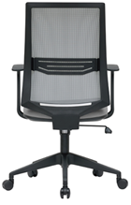
2020 Product Roadmap : Where We're Going
Height Adjustable Standing Desk Chair
Specifications
Dimensions:
Extension range:
Materials:
Weight capacity:
Features
Simple clamp-on design works with more desk tops
Ball-bearing sliders make it easy to retract and extend
Durable MDF constructions with heavy-duty steel brackets
Smooth all black finish

Slide 21

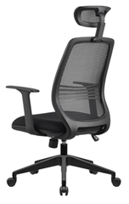
2020 Product Roadmap : Where We're Going
Ergonomic Height Adjustable Standing Desk Chair with Headrest
Specifications
Dimensions:
Extension range:
Materials:
Weight capacity:
Features
Simple clamp-on design works with more desk tops
Ball-bearing sliders make it easy to retract and extend
Durable MDF constructions with heavy-duty steel brackets
Smooth all black finish

Slide 22
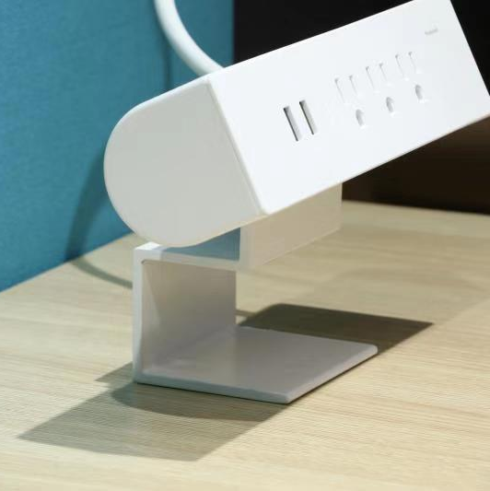
2020 Product Roadmap : Where We're Going
Clamp-on Adjustable Desktop Surge Protector Power Strip
Specifications
Dimensions: 8.6" x 7.8" x 2.4"
Outlets: 3 Grounded 120V
USB: 2 @ 2.1A each
Surge protection: 800 Joules
Features
Desktop powerstrip with easy clamp-on design
3 grounded outlets and 2 USB TYPE-A charging ports
Surge protection up to 800 joules
Tilt adjustable for easy power cord management

Slide 23
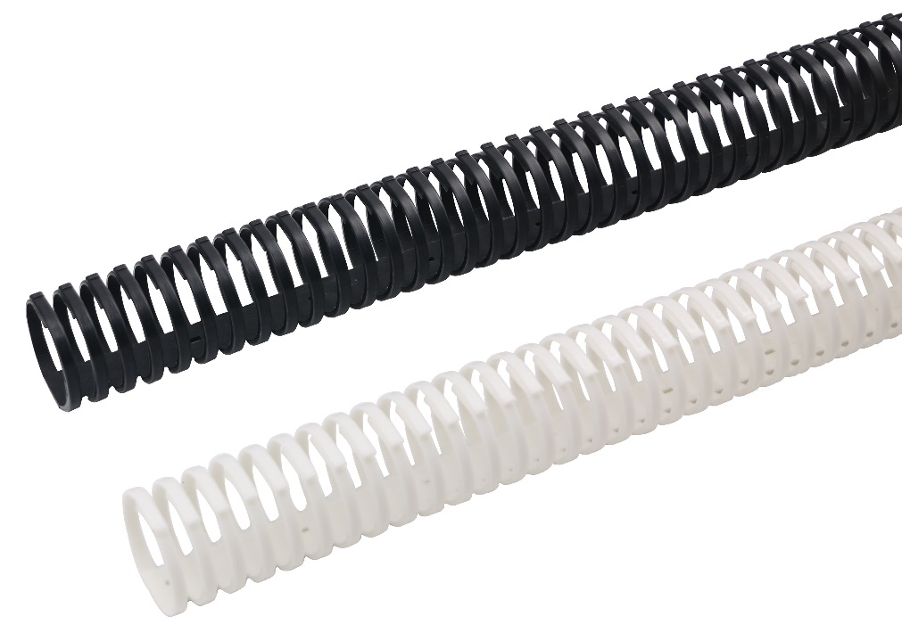
2020 Product Roadmap : Where We're Going
Coil Tube Cable Management Sleeve
Specifications
Dimensions: 21.6" L x 1.9" diameter
Materials: Plastic
Colors: White/Black
Features
Flexible plastic spiral for easy organization of computer cables
Gaps allow for cables to leave the spiral where you need them
Lightweight and durable for reliable long-term use
Perfect accessory for computer users with AIRLIFT desks

Slide 24
2020 Product Roadmap : Where We're Going
Cable Management Spine for Electric Adjustable Standing Desks
Specifications
Dimensions: 28.4" L x 2.6" W x 1.4" D
Materials: Plastic
Colors: White/Black
Features
Heavy-duty interlocking chain for cables and wires
Gaps allow for cables to leave the spiral where you need them
Lightweight and durable for reliable long-term use
Perfect accessory for computer users with AIRLIFT desks

Slide 25
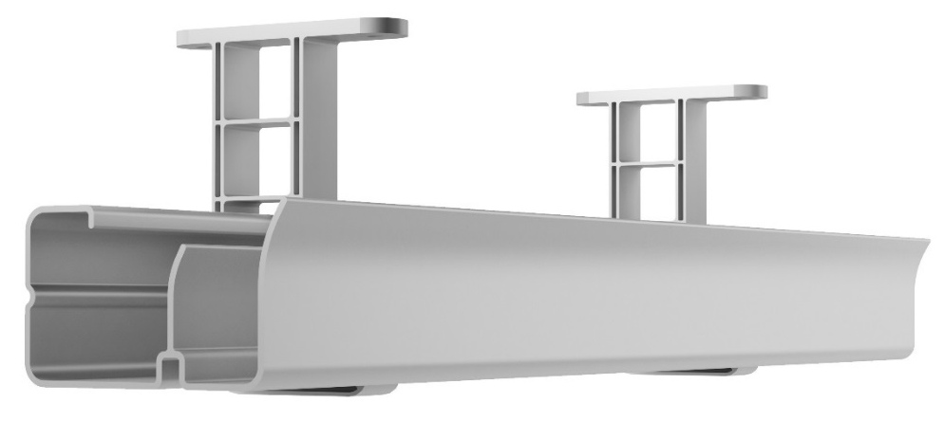
2020 Product Roadmap : Where We're Going
Cable Management Tray for Electric Adjustable Standing Desks
Specifications
Dimensions: 21.6" W x 3.5" x 2" H
Materials: Plastic-steel
Features
Lightweight and sturdy cable tray designed for standing desks
Dual channel design for spacious and easy organization
Plastic screw-in hanging brackets
Also available in 17", 24", and 40" widths

Slide 26
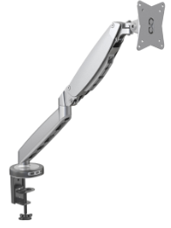
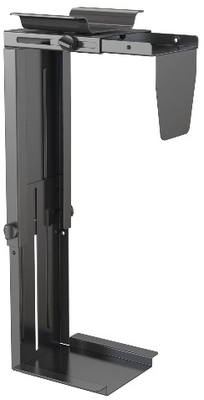
2020 Product Roadmap : Where We're Going
New accessories help our desks cater to a wider variety of office customers with a more sophisticated and professional experience.
Cable Management Spine
Monitor Arm (Metallic Gray/ White)
PC Case Mount

Slide 27
Upcoming & Current Products

Slide 28
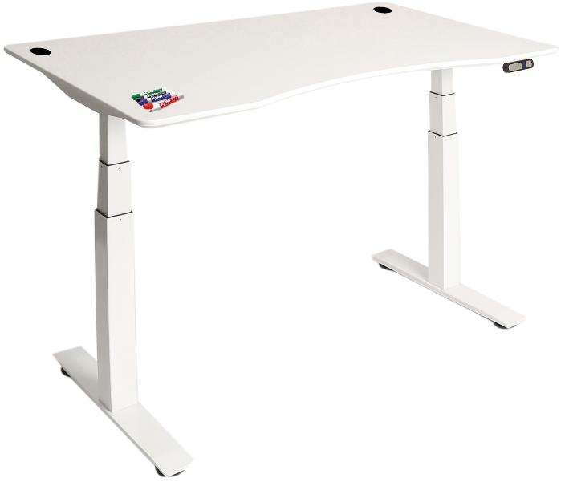
Frame Model: OFF65815
Frame + Top MSRP: $549.99
AIRLIFT® S3 Electric Height-Adjustable Standing Desk Dry Erase Table Top with Beveled Bottom Edges, 54" x 30"
Specifications
Top Material: MDF with laminate finish
Top Area: 54" x 30" x 1" thick
Weight Capacity: 264 lbs.
Top Color: White polyethylene
Frame Color: White
Adjustment Type: Electric Motor
Adjustment Range: 28.7" to 48.4"
Overall Size: 54" W x 30" D x (22.8" H to 48.4" H") H
Features
Unique dry-erase board finish lets you keep notes close at hand.
Smooth, easy-to-clean writing and worksurface.
LED height controller with 4 memory settings for quick adjustment.
Powerful dual motors lift up to 264 lbs. smoothly with the push of a button.
Commercial-grade steel, 3-stage frame provides stability when fully raised.
Edges are finished in black polyethylene for a smooth and sleek look.
Easy assembly takes 15 minutes or less.
Dry-Erase

Slide 29
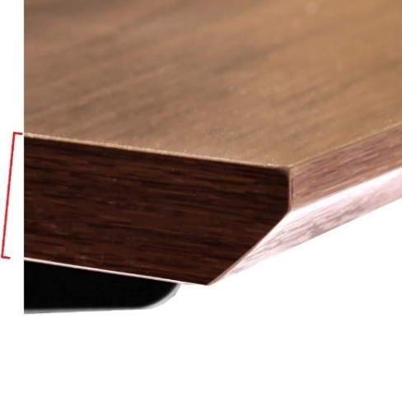
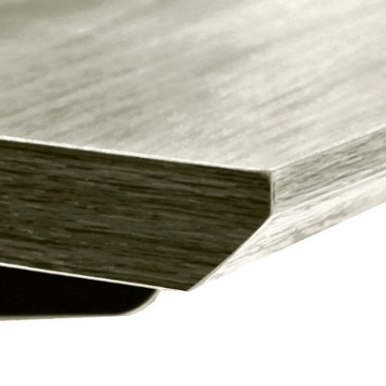
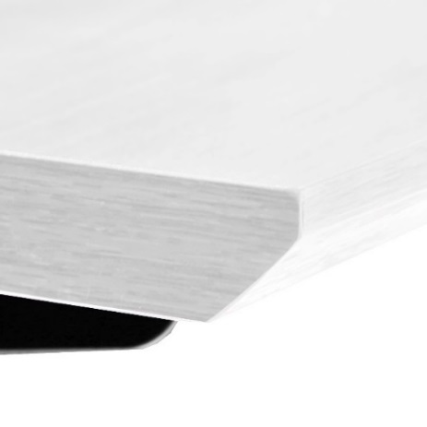
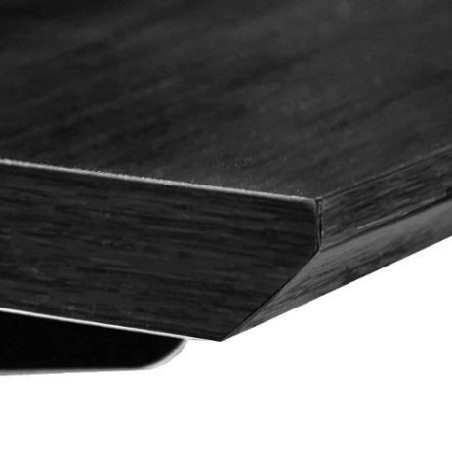
We're moving forward with these colors.
These are our best sellers as informed by sales on the S3 and S2 desks.
We're planning implementing more sizes, including:
72" x 24"
60" x 30"
48" x 24"
Walnut
Ashwood
White
Black

Slide 30
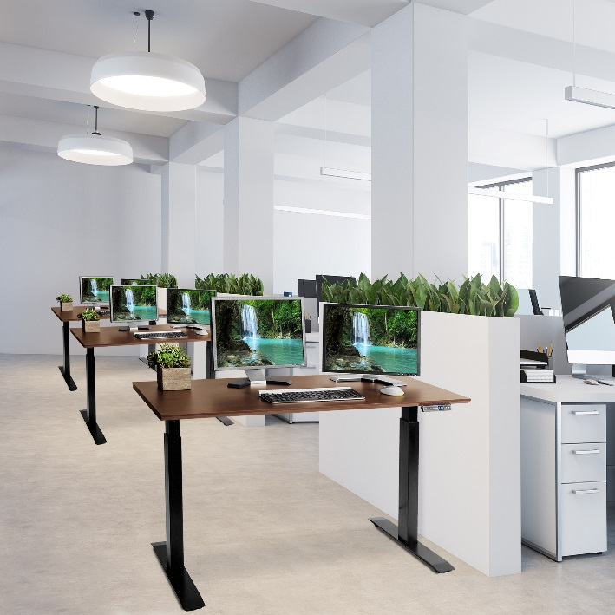
OFF65894
MSRP: $399.99
AIRLIFT® Professional Electric Height-Adjustable Standing Desk
Specifications
Top Material: MDF with laminate finish
Top Area: 48" x 24" x 1" thick
Weight Capacity: 176 lbs.
Top Color: Walnut
Frame Color: Black
Adjustment Type: Electric Motor
Adjustment Range: 28.7" to 48.4"
Overall Size: 48" W x 24" D x (28.7" to 48.4") H
USB-A Ports: 1 @ 5V/2.4A
Features
LED height controller with 4 memory settings for quick and consistent adjustment.
Powerful dual motors lift up to 176 lbs. smoothly with the push of a button.
USB charging port keeps devices powered up no adapter required.
Commercial-grade steel, 2-stage frame provides stability when fully raised.
Flat ends make side-by-side use easy for open offices and worksites.
Durable laminate finish available in a variety of hues and textures.
Easy assembly takes 15 minutes or less.

Slide 31
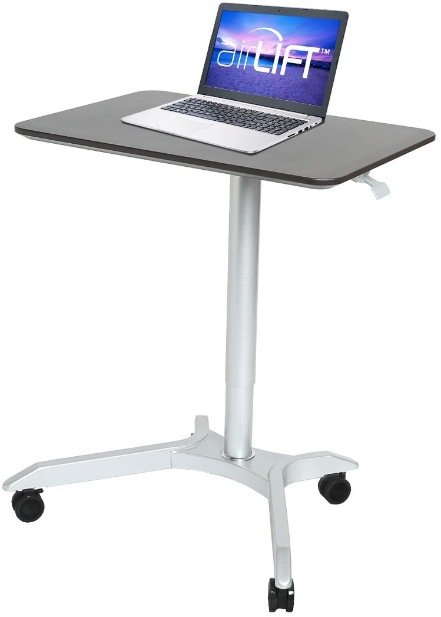
Model: OFF65800
MSRP: $199.99
AIRLIFT® XL Sit-Stand Mobile Desk, Espresso
Specifications
Top Material: MDF with laminate finish
Top Area: 28.1" W x 19.6" D
Top Color: Espresso
Frame Color: Silver
Adjustment Type: Pneumatic
Adjustment Range: 27.1" to 41.9" H
Overall Size: 28.1" W x 19.6" D x (27.1" to 41.9") H
Weight Capacity: 35 lbs.
Features
Extra-large desktop with smooth surface
Effortless pneumatic height adjustment with lever-operated gas-air cylinder
Steel base and aluminum column powder-coated in silver
Wide base provides wobble-free use
Four 2.36-inch casters (2 locking) make it easy to take your work with you
AIRLIFT® Adjustment Lever

Slide 32
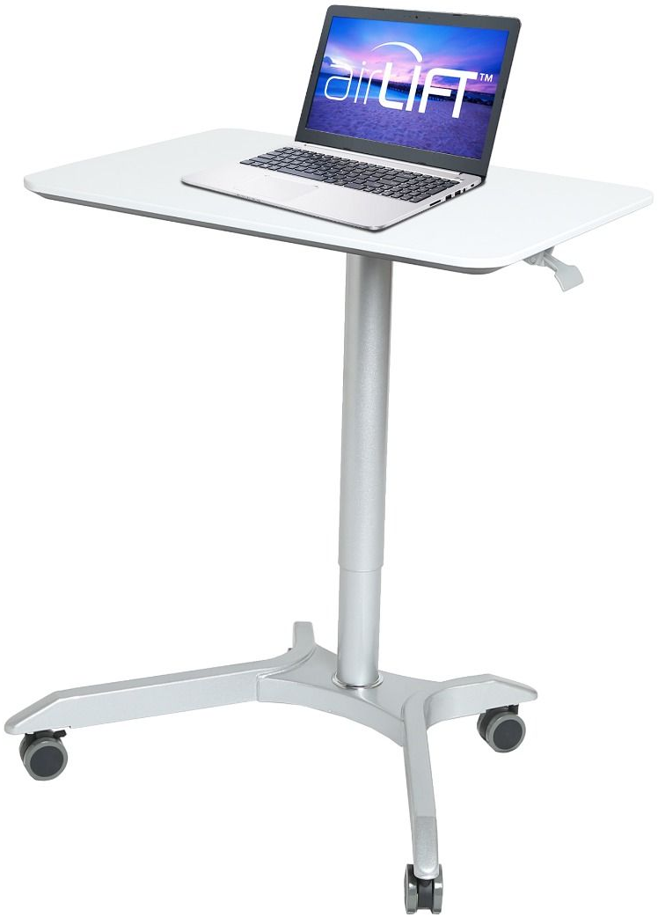
Model: OFF65801
MSRP: $199.99
AIRLIFT® XL Sit-Stand Mobile Desk, White
Specifications
Top Material: MDF with laminate finish
Top Area: 28.1" W x 19.6" D
Top Color: White
Frame Color: Silver
Adjustment Type: Pneumatic
Adjustment Range: 27.1" to 41.9" H
Overall Size: 28.1" W x 19.6" D x (27.1" to 41.9") H
Weight Capacity: 35 lbs.
Features
Extra-large desktop with smooth surface
Effortless pneumatic height adjustment with lever-operated gas-air cylinder
Steel base and aluminum column powder-coated in silver
Wide base provides wobble-free use
Four 2.36-inch casters (2 locking) make it easy to take your work with you
AIRLIFT® Adjustment Lever

Slide 33

Model: OFF65905
MSRP: $199.99
AIRLIFT® Overbed Medical Pneumatic Adjustable Table, White
Specifications
Overall Size: 30" W x 19" D (24.4" to 37.2" H)
Height Adjustment Range: 24.4" to 37.2" H
Adjustment Type: Pneumatic
Top Material: Wood with PVC finish
Top Color: White
Frame Material: Steel
Frame Color: White
Features
Offset cylinder for convenient over-the-bed use and with other furniture
Quick and effortless AIRLIFT adjustment with the squeeze of a lever
Durable, spill-proof, easy-to-clean PVC laminate desktop
Beveled edges for ergonomic comfort and a modern aesthetic
Steel construction for strength and durability
Low profile base with small casters (2 locking) for smooth-gliding mobility
Weight capacity: 33 lbs.

Slide 34
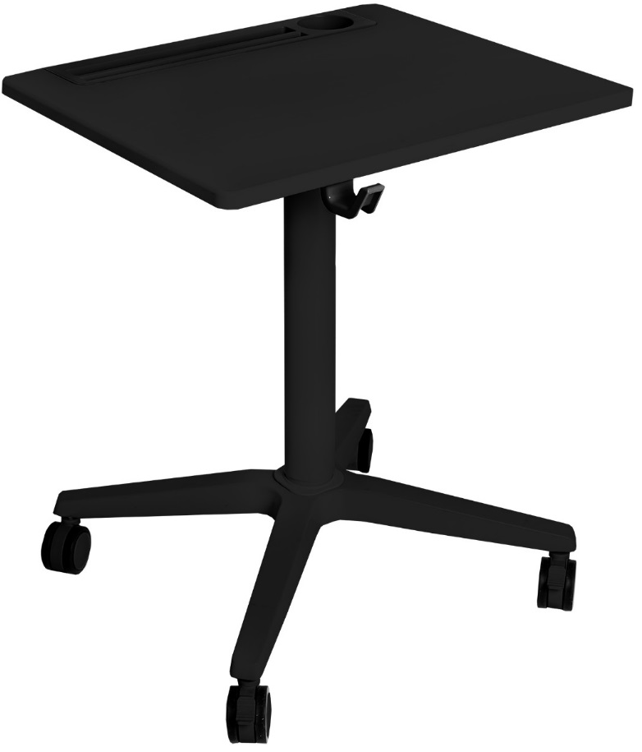
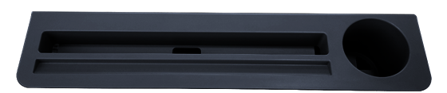
Model: OFF65903
MSRP: $249.99
AIRLIFT® XL Sit-Stand Mobile Desk with Cup Holder, Black
Specifications
Overall Size: 25.6" W x 21.6" D (30" to 45.6" H)
Height Adjustment Range: 30" to 45.6" H
Adjustment Type: Pneumatic
Top Material: Wood with PVC finish
Top Color: Black
Frame Material: Steel
Frame Color: Black
Features
Large tabletop with spill-proof PVC laminate finish
Quick and effortless adjustment with a squeeze of the AIRLIFT lever
Hanger hook for backpacks, bags and purses
Built-in cup holder and storage tray for pens and electronics
Steel construction for strength and durability
Large casters (2 locking) for smooth-gliding mobility
Weight capacity: 33 lbs.
Hanger hook

Slide 35

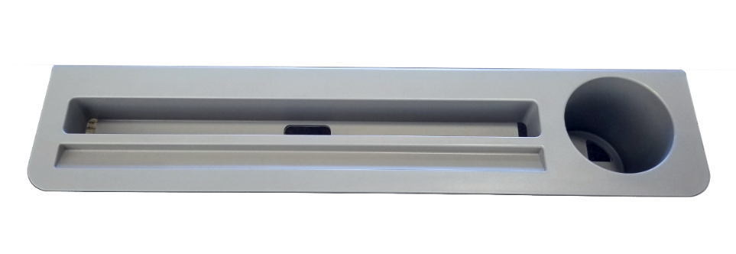
Model: OFF65904
MSRP: $249.99
AIRLIFT® XL Sit-Stand Mobile Desk with Cup Holder, White
Specifications
Overall Size: 25.6" W x 21.6" D (30" to 45.6" H)
Height Adjustment Range: 30" to 45.6" H
Adjustment Type: Pneumatic
Top Material: Wood with PVC finish
Top Color: White
Frame Material: Steel
Frame Color: White
Features
Large tabletop with spill-proof PVC laminate finish
Quick and effortless adjustment with a squeeze of the AIRLIFT lever
Hanger hook for backpacks, bags and purses
Built-in cup holder and storage tray for pens and electronics
Steel construction for strength and durability
Large casters (2 locking) for smooth-gliding mobility
Weight capacity: 33 lbs.
Hanger hook

Slide 36
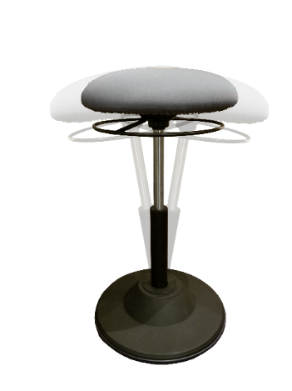
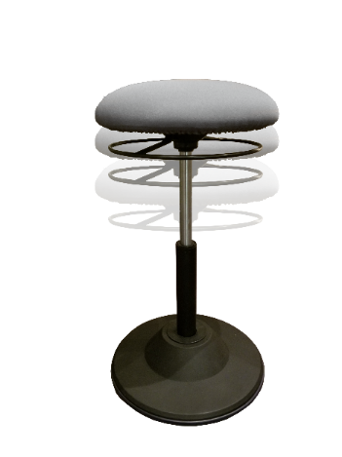



Model: TBD
MSRP: $99.99
AIRLIFT® 360 Sit-Stand Adjustable Ergonomic Active Balance Stool
Specifications
Overall Size: 15.75" diameter x (20" to 28")
Height Adjustment Range: 20" to 28"
Adjustment Type: Pneumatic
Seat Material: Molded Foam
Seat Color: Black, Gray, Blue
Frame material: PVC
Frame Color: Black
Weight capacity: 250 lbs.
Features
Wobble up to 10° in any direction for active sitting and standing
Simply grab the AIRLIFT adjustment ring to lift and lower
Supportive molded foam seat with 360° of swivel
Large round base with non-slip bottom

